Slide 1
Scope for Change: Scope’s transition to social change
Ceri Smith and Miriam Steiner
February 2019

Slide 2

Session structure
Introductions
Everyday Equality and the move to social change
Scope for Change programme
Discussion

Slide 3
What do you know about Scope?

Slide 4
Our history

Slide 5
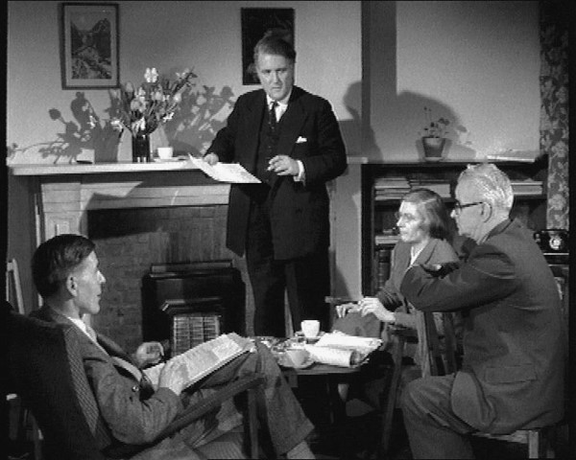
The birth of The Spastics Society
“A new and powerful society has been formed to press, argue and fight to get better treatment for spastic sufferers. Would you ask all sufferers or their relatives to write to the National Spastics Society at the above address and start helping the Society?”
Ian Dawson-Shepherd, Chairman, 1952

Slide 6
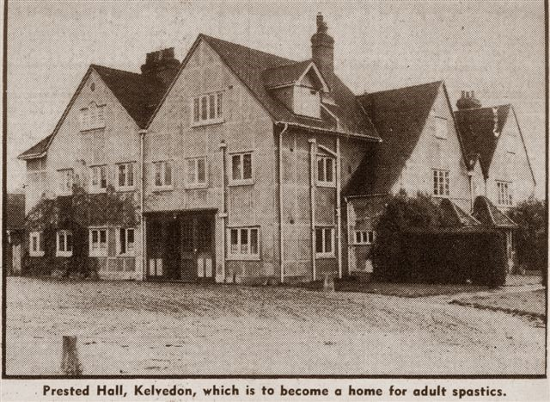
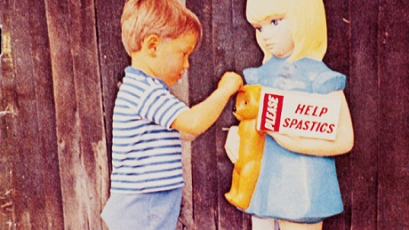
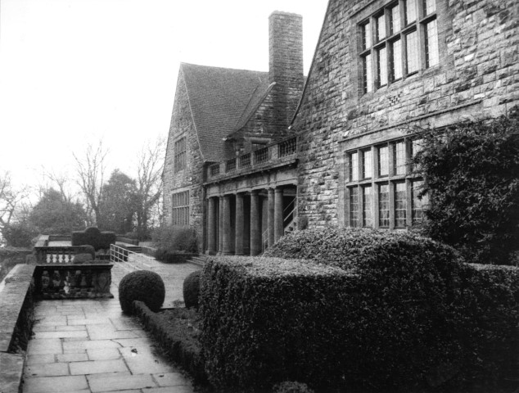
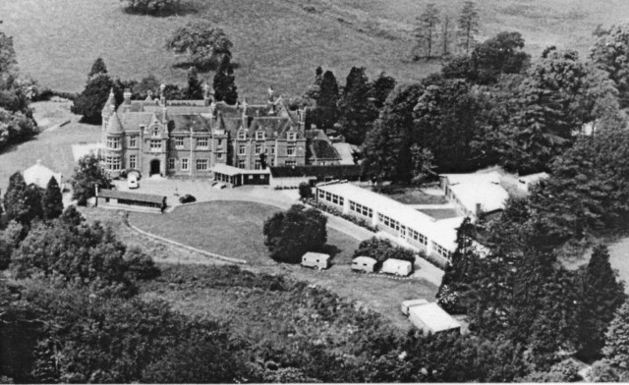
A campaign that became a charity…

Slide 7
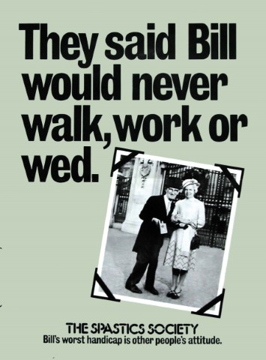


Scope – campaigning for change

Slide 8
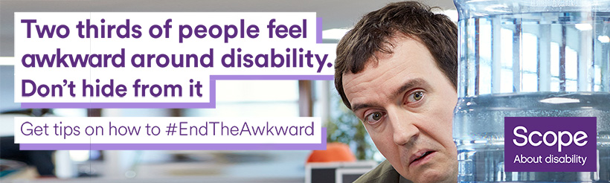
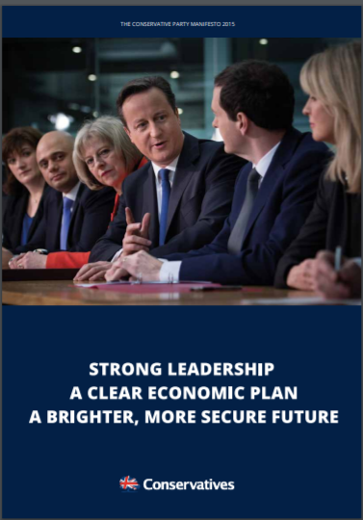
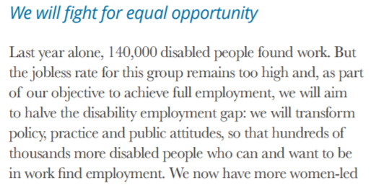
Scope – campaigning for change

Slide 9
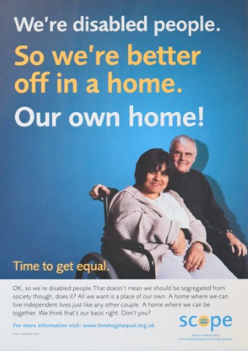
So what’s the problem…?
Scope’s services were irrelevant to the vast majority of disabled people
Scope’s credibility and effectiveness as a campaigning organisation was hampered by the tension between service delivery and social change
Lack of focus – disconnect between ambition and activity
Low reach and unable to evidence impact
Strong competition

Slide 10
Scope’s new strategy

Slide 11
(Re)Introducing Scope
We’re a strong community, of disabled and non-disabled people, with a shared vision of equality for disabled people.
We provide practical advice and emotional support whenever people need it most.
We use our collective power to change attitudes and end injustice. And campaign relentlessly to create a fairer society.
Notes:
Led by Board and Executive
Extensive consultation and engagement with disabled people
Debate: Ambition v Activity
Desire for fundamental change
Agreed a high-level proposition
Characteristics of a future organisation

Slide 12

Making social change Scope’s core business
Driven by mission to achieve a society where all disabled people enjoy equality and fairness
Campaigning and service provision are now two sides of the same coin
Desire to do fewer things, better, reaching many more people
Commitment to impact measurement and reporting

Slide 13
Strategy – our approach
Empower disabled people to be the changemakers
Act on robust evidence and insight
Change attitudes in every action we take
Reach disabled people at scale to create change
Promote disabled leaders and role models to make disability visible
Lead the change through Scope’s own practices

Slide 14


Slide 15
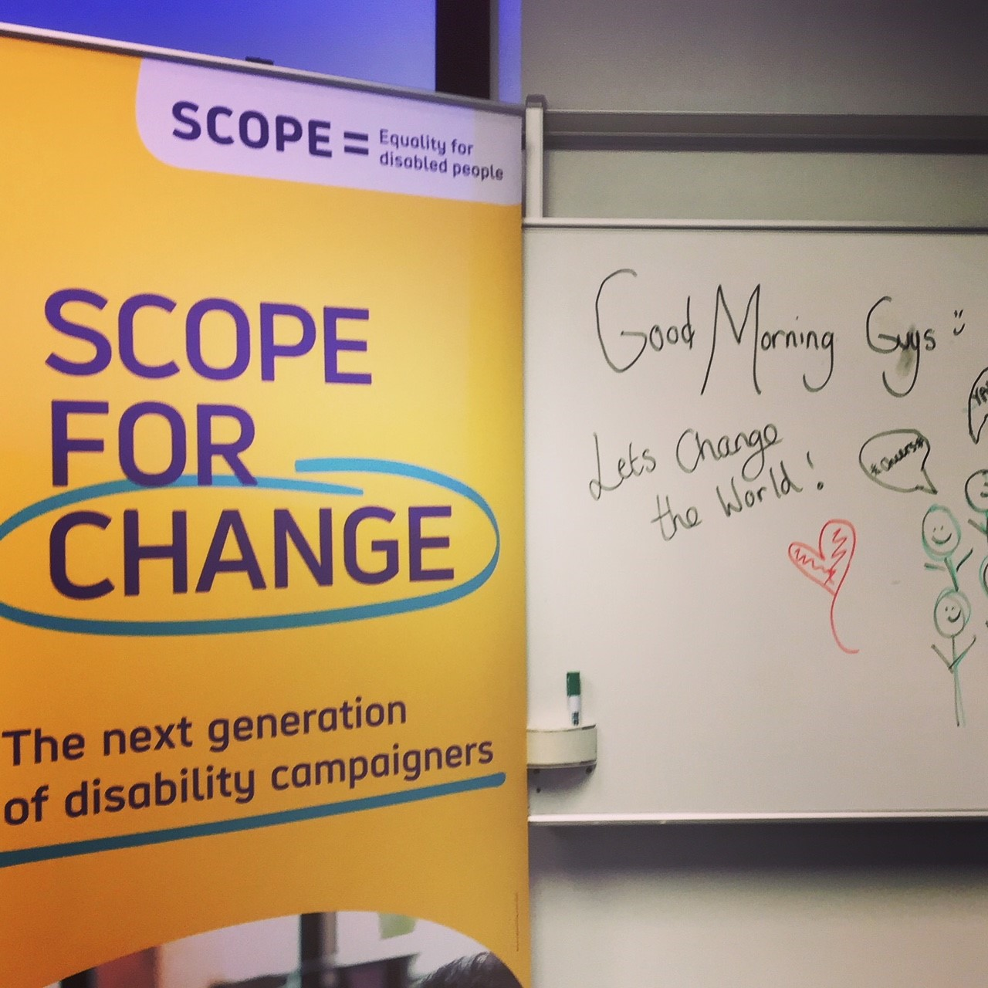
The programme
18-25 year olds
Selective
3 day residential training event
6 months of tailored support
Webinars
1-1 catch ups
Continued engagement with Scope post-programme

Slide 16
Why Scope for Change?
Supporting the next generation of disability activists
Bringing disability into the new social change landscape – disability is often the ‘Cinderella’ of equality issues
Making change where it’s needed and on issues which might go beyond our strategic focus
Recognising that young disabled people’s experiences make them the experts on their campaigns

Slide 17
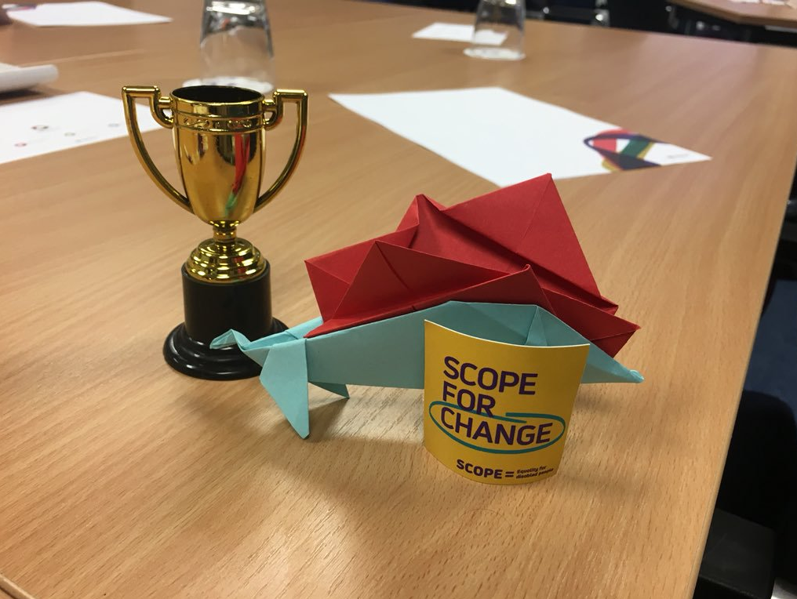
Guiding principles
Accessibility and inclusivity
Respect
Encourage confidence
Self-directed programme
Validity of all contributions
Constant feedback
Maintaining focus on impact – both individual and strategic

Slide 18
Recruitment
Three questions:
Why you are applying for the Scope for Change programme?
Tell us about a time you have acted to change something, or an issue you'd like to take action on
Tell us about campaigns that have influenced or impressed you
Notes:
Ask attendees their ideas on recruitment

Slide 19
Training offered in 2018/19
Campaign strategy
Social media and digital campaigning
Storytelling and video
Influencing techniques
Speakers
Bal Deol
Robin Hindle Fischer
Esther Foreman
Samantha Renke
Stephen Timms MP
Introduction to Parliament
Media training
Blogging

Slide 20
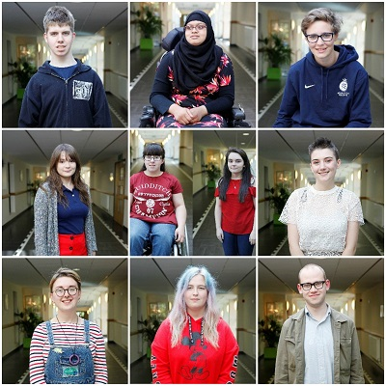
2018-2019 Campaigners
Across England and Wales
Mix of ages from across the 18-25 range
Variety of levels of education, employment and backgrounds
Mixed impairments

Slide 21
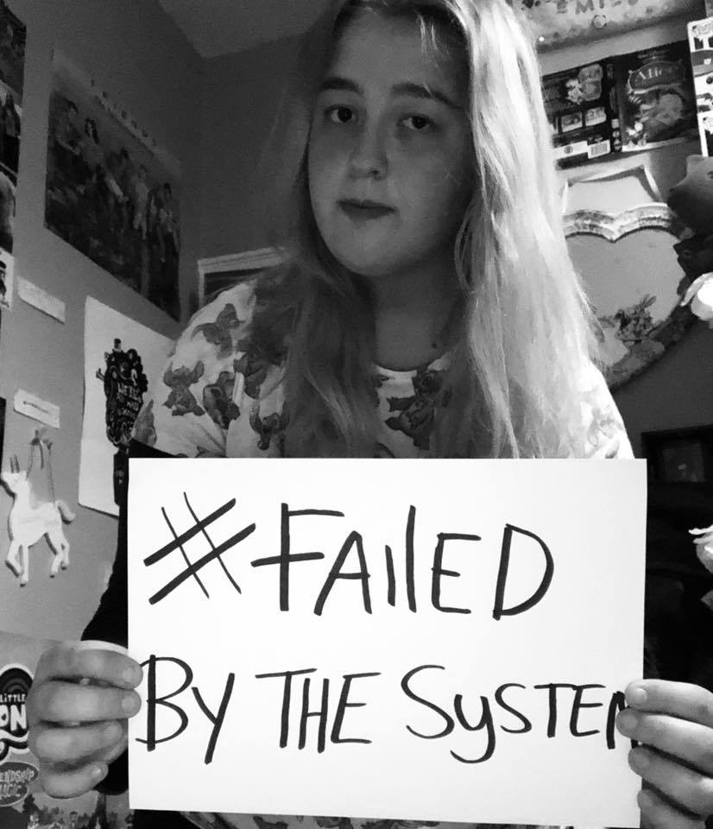
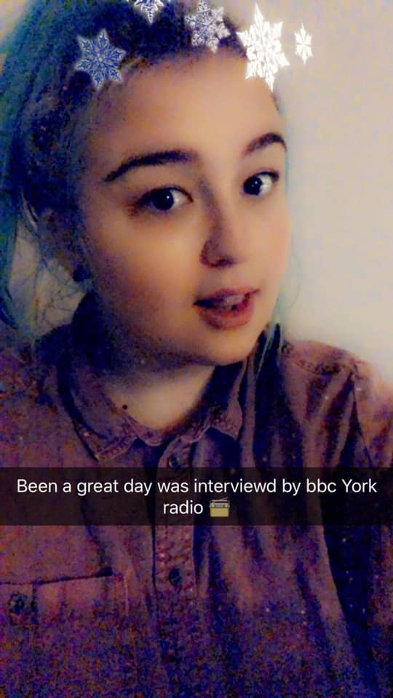
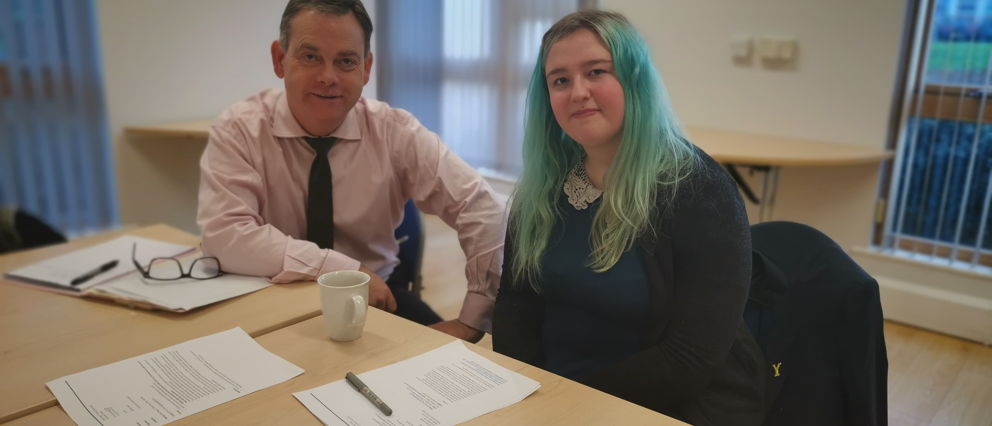
Emily
19 years old, lives in Selby, Yorkshire
Had to leave mainstream school
Couldn’t get a suitable college placement, one year with no education and was placed into unsuitable Pupil Referral Unit (PRU)
Advocating more support for disabled pupils to stay in mainstream education
Gained support from her local MP
Worked with local media
Hundreds of signatories to her petition
Created video from user generated content

Slide 22
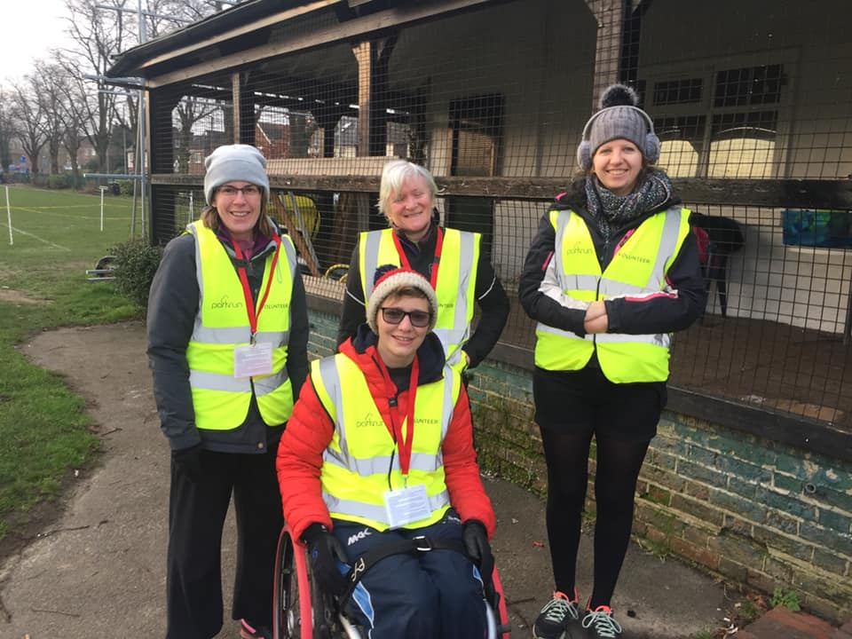

Claudia
23 year old, student at Queen Marys, Twickenham
Keen volunteer at major sports venues and events e.g. Lord’s Cricket Ground
Treated badly by some volunteer managers when she began using a wheelchair
Found she had less legal protections against discrimination as a volunteer
Working to change attitudes, promote awareness of the issue
Supporting next generation of disabled students

Slide 23
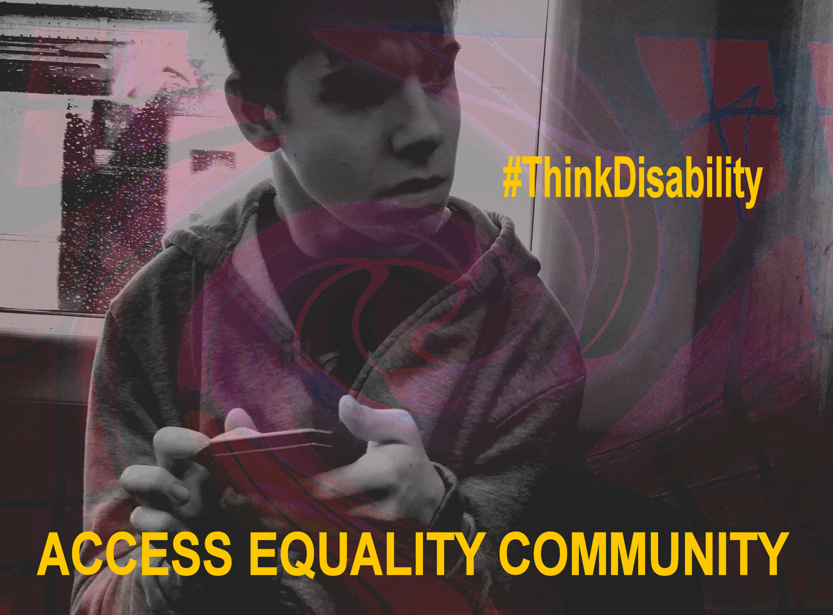
Alfie
19 years old, lives in York
Spent years as a patient at the child development center in York Hospital
No changing places toilet, one-person accessible toilet
Set up a walk-through with wheelchairs for senior hospital staff
Trust have audited multiple sites
Introduced new signage and a new programme of works
Founding of new focus group with local disabled peoples organisations

Slide 24
And the rest…
Sam Fowkes Reducing the number of disabled pupils excluded from schools in Sandwell and Dudley
Freya Matthews Changing attitudes to people with invisible disabilities
Raisa Hassan Promoting the use of positive language around disability in families
Sophie Thomas and Chloe Morgan Making it a legal requirement for all schools to be accessible
Amy Walker Increasing the employment of autistic, neurodiverse and disabled people
Tasha Krywald Campaigning to get disability education into schools
Samantha Thomas Improve the way GPs treat over and under-weight patients

Slide 25
What we’ve learnt

Slide 26
Our strategic choice
A visionary, ambitious board is critical. Your trustees don’t need to be campaigners, but they need to trust you.
Communicate, translate, collaborate, be accountable, and accept there are many ways to deliver social change
Patience is key; change doesn’t happen overnight. How do you keep your staff, supporters and beneficiaries motivated and focused on the future?
Get out there and do what you do best. Down to you to ensure your profile or influence don’t go into decline while others focus on internal change.

Slide 27
Scope for Change
True accessibility can feel radical
First time many people had an accessible experience with other disabled people
1-1 support is vital
Engagement changes over 6 months
Campaigners are all experts in their own experiences

Slide 28
Discussion

Slide 29
Discussion
Do you have any questions for us?
How does this compare with your experiences of strategic shift or losing control to people you work with?
What blocks do you find in strategic shift and/or establishing programmes which are self-directed?

Slide 30
Thank you
Keep in touch:
Ceri.Smith@scope.org.uk
Miriam.Steiner@scope.org.uk
@Scope
#ScopeForChange

