Slide 1
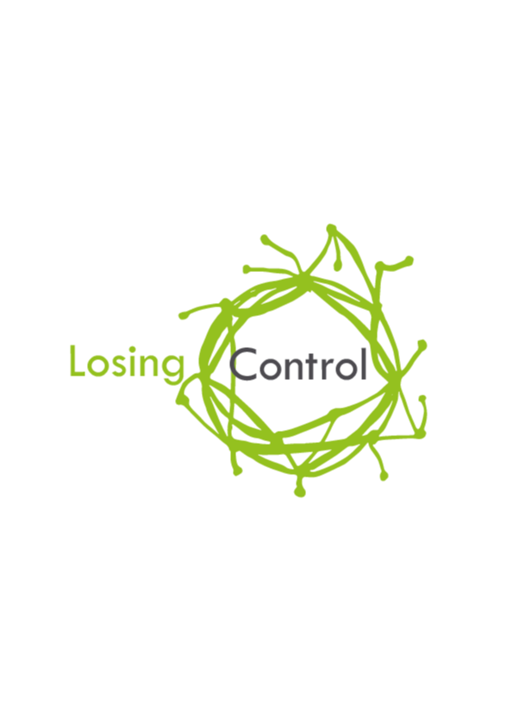
DETAILED FEEDBACK – FEBRUARY 2019

Slide 2
POST EVENT SURVEY RESULTS
Based on 119 survey responses.
269 attendees on day 1 = 44% response rate

Slide 3
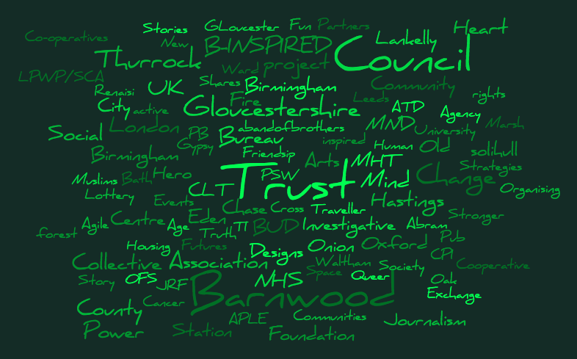
Name of Organisation

Slide 4
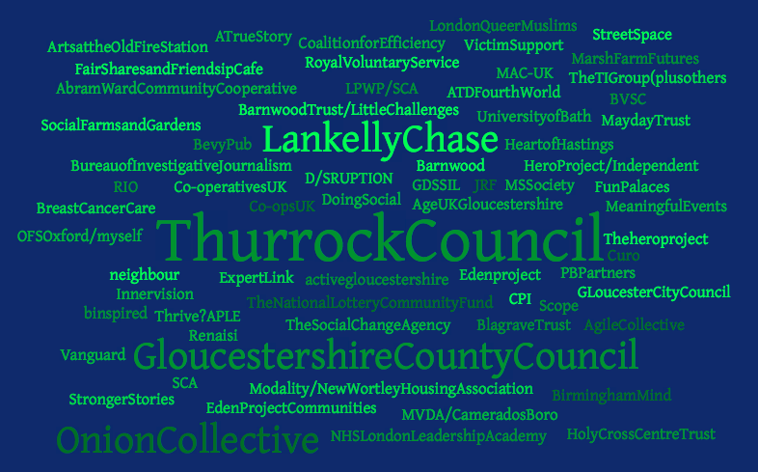
Name of Organisation

Slide 5
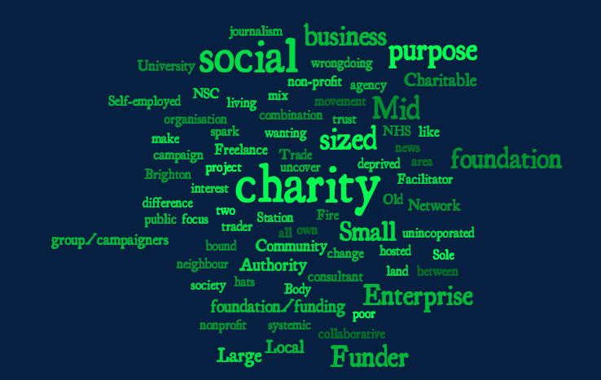
Type of Organisation

Slide 6
Type of Organisation

Slide 7
Did you host a session?

Slide 8
Thoughts on Open Space sessions
It was so lovely and I had some great conversations met some awesome and felt very calm and relaxed after and enjoyed it loads
Yes I attended one during last session on Tuesday. It was just casual conversation. I would have liked a more focused open space arrangement.
No - I don't know how well this worked for you, but at past conferences I've seen them work best when time is blocked out for just open space, so it doesn't compete against scheduled speakers
Yes- I used the space to share ideas and information with the Hero Project and London Queer Muslims
Popped in and out - important part of event.
the "looking after ourselves" session was very helpful
yes, we arranged an number of separate meetings including workshops we missed. This was great as we couldn't all attend all of the workshops.

Slide 9
Any other comments or reflections on the sessions you attended?
I found the sessions in the Eden Room extremely helpful. Very well facilitated at a nice pace and with real insight....with participants sharing honestly, with care and compassion.
I enjoyed the sessions but felt that many were rushed. There didn't seem to be time to discuss things properly and therefore when asked for input it was difficult to do so meaningfully. There was often lots of information to take in, process quickly and respond promptly! The pace of the some sessions was different, slowed down and more time given to have proper conversations. During one of these conversations within that session one participant had mentioned she walked out of a session the day before because she tried to put her point across and wasn't being heard and felt ignored and undervalued. I understand this could be for individual reasons but I think there was something about the set up and style of some presentations that didn't quite create the best environment to encourage full participation and inclusion.
I left the one session to attend another one, I was finding the intensity of small rooms and power point heavy presentations difficult, but that's not to say the session wasn't good, I just needed air!
I really enjoyed the opportunities for informal conversation and connection and loved the Spaces area.
I really like that they were 90mins - enough time to really get into it and let people in the room speak, share etc.
A great group of attendees and speakers, thank you!
Interesting debates and each session's content was very engaging and I found useful.
I thought that every session I attended was thought provoking, stimulating and excellent.
Lack of respect of some attendees towards those with disabilities.

Slide 10
Any other comments or reflections on the sessions you attended? (cont.)
Loved it all
Some really high quality delivery with a good spectrum from listening right through to high energy participation. I also really appreciated the Eden Room. I’m still a bit fragile & in there were some practical sessions delivered with empathy & skill.
Loved the spirit of the 2 days. Cryptic titles for some sessions frustrating. Space not conducive for voting with your feet. Felt to me like there was a bit of navel-gazing at points. The authenticity far overweighed some of the 'disappointments'. Good opportunity to network and organisers bent over backwards to make connections. Refreshing to just be another conference and move of a 'movement' with opportunities for people to get involved and own this. An element of preaching to the converted. I probably didn't read the event purpose well enough, but I was hoping for more of a mixed audience, more people with different types modes of control to lose. Happy to contribute to any next steps in some way, at least by taking part learning and sharing.
Some were just too full to be comfortable. Some I could not get in, especially on the first day. The doors were closed so you couldn't really "vote with your feet" by dropping in for a bit.
Stimulating sessions, food for thought, rooms sometimes too closed and full.
Thankful for the opportunity to be apart of losing control and to see how we can get some control back together.
One particular session was a huge eye-opener! Attending just this session would have been worth the whole two days, but I got something from all sessions.
The diversity and variety of interesting sessions was excellent. The commitment from the session presenters was palpable. It was truly the best and most meaningful event I have ever attended - thank you.

Slide 11
Any other comments or reflections on the sessions you attended? (cont.)
The best sessions were the most interactive - I wish I had taken part in some of the more experiential ones as well. The best sessions were well-structured with a great balance of group work and good facilitation of larger discussion. I was a bit disappointed with one session- perhaps because I've read around some of the content before so it wasn't new but also because it was a lot of the host speaking or answering questions. It also suffered from the fact it was the last session of the day and the room was too big for it so the energy level was lower.
On the plenaries, my main comment would be the tendency for older white men to be the ones asking all the questions. This was way out of proportion with the diversity in the room and made me (a younger white man) much less willing to stick my hand up and take away the chance from someone with less privilege. I'd love to see the hosts employ a women-first approach (this has been shown to create a pattern of more women asking questions) and openly point out when it's mostly men talking. This dynamic can certainly be a lot worse in other settings (there wasn't too much in the way of long comments badly disguised as questions) but I think we can strive for better given the theme.
Overall, the sessions were excellent and I learnt a huge amount.

Slide 12
Any other comments or reflections on the sessions you attended? (cont.)
The sessions I attended were very engaging and different in content. I've come away with a new thinking approach and like my preconceptions have been challenged.
The more concrete the content, the better. When it was about something that could be seen as a mechanism of losing control it worked well. When it was about an amorphous idea, the session didn't work (in my opinion). People brought their views and preconceptions, but these sorts of session just became a bit of a social sector talking shop.
The level of good facilitation was relatively poor - clearly there were often valuable things the organisers had to say, but many seemed not to have thought through exactly how they could put that across most usefully in the time allotted, to keep the audience engaged and also manage people butting-in, who tended to be older white men. Some of the sessions did not live up to expectations either, given the descriptions that they had written for themselves, and at times tended towards self-promotion a little too obviously.
The ones I attended were pretty great. I wish there had been more space in the Margaret Fell room but other than that, I really enjoyed being there.
Some sessions felt like a sales pitch, when the room wanted to discuss the power dynamics at play. The dynamic of one expert talking felt at odds with the rest of the event.
The majority were insightful; the presenters were engaging and inspiring and willing to let the sessions evolve rather than follow a prescriptive structure and I left them all more informed/aware/skilled than I had previously been.
The second session didn't sit with the feel of the day. It was still interesting but the hands-on approach wasn't there as it was with other sessions. The other sessions I attended were thought provoking, fun, and relaxed.

Slide 13
Any other comments or reflections on the sessions you attended? (cont.)
The sessions were genuinely generative and generous
They were on the whole great, though I felt in combination (due to my own choosing, too) that I didn't experience as much discussion on "losing control" as I'd expected. The focus of some sessions wasn't on this at all, while others did explore it through the way in which the speakers had lost control. I really enjoyed it, but on the whole feel I came away with slightly less ideas and inspiration for losing control and redistributing power in my work than I had hoped to.
Yes interesting and valuable
The sessions were mainly very good. Perhaps some were a bit like a lecture - but still room for comment and engagement
Truly thought-provoking. Inspired me think creatively about my own practice and the work that I am seeking to do in systems leadership and organisation development in health and social care.
Very good two days. So much to learn and workshops I attended very thoughtful.
While it was still difficult to choose, it wasn't impossible because there were only 3 slots a day. I was grateful for that
They were all great

Slide 14
On a scale of 1-10 (1 = not at all and 10 = absolutely) did you feel that Losing Control was genuinely peer led (i.e. the sessions and content was delivered by practitioners with real life experience of the content).

Slide 15
Did you find the attendee brief helpful?
Great but I like less info- that’s just me!
More detail on workshops would have helped me choose better
Received it too late to find it useful
Skim read - mostly for logistics. Felt a lot of info for 'losing control'
Would have been helpful to have a bit more info on each of the sessions to help choose - some of the titles were a little ambiguous!
Had a bit of a heads up from the organisers
NB Those who marked “didn’t receive” include people who turned up on the day and late replacements for unwell colleagues etc

Slide 16
Did you listen or read any of the Losing Control blogs or podcasts before the event?

Slide 17
Did you find the session brief useful? (Hosts only)
NB Those who marked “didn’t receive” and “didn’t read” include people who turned up on the day to assist and some who weren’t leading the session so decided they did not need to read the info

Slide 18
Was there anything else that we could have done differently/included in either the attendee or host briefing?
A few more details about workshops to help us choose, but this is a minor point.
I felt the descriptions of the workshops could have contained less jargon
A way to know how many attendees might provisionally attend your session. Also, some kind of details exchange. Not everyone filled in the online sheet and I wouldn't remember the names of everyone I met to be able to marry up the people I wanted to touch base with after.
I found the layout of the venue a little confusing but the volunteers were so helpful it didn't cause any real issues
I liked the fact that attendees could dip in an out. However I don't think some hosts were prepared for that. Hosts should design the sessions taking this into account.
For hosts, would have been helpful to have a list of attendees' organisations so we could understand our audience better, and to know of any accessibility requirements people might have. Of course we should always plan and design for accessibility, but it can be helpful to have specific info.
I spoke with someone regarding accessibility & inclusivity. One session apparently excluded some participants because of a physical ability barrier and I noticed some exclusionary practices in another session. Did hosts receive a checklist re how to present in an inclusive way? eg if you show a photo please describe it for any visually impaired persons present before talking about its relevance in your presentation; if you have a physical activity is it fully inclusive? If not how might you make it so? etc
Get people to indicate their preference to gauge how big a room needed to be.
Get the podcast on a more widely distributed platform. I wasn't able to get it on PocketCast.
I would have read the blog posts if I hadn't been away the week before.
Some sessions I wanted to go to I could due to lack of space. Knowing capacity limit would be good for heads up and repeat sessions or ability to access content in other ways for missed sessions due to number or clashes would be great.

Slide 19
Was there anything else that we could have done differently/included in either the attendee or host briefing? (cont.)
I would have liked a little bit more detail on the actual sessions as from some of the titles it wasn't always clear what the session was about
Networking support, list of those attending and their organisations so I could have made better use of the network
It was well detailed, Thank you!
No it was beautiful and how much work actually went In to the event and dedication showed.
Lack of respect of some attendees towards those with disabilities.
No, thought the blogs were particularly a great idea
Lack of information to follow up is interesting. Finding it difficult to put everything in my mind into context, and the lack of materials afterwards is both helpful as it makes me think, but also disquieting as feel need to refresh on things I heard but need to put into context
No. The preparation and communication was exceptionally good for an event like this.
Perhaps just a bit more info about the sessions - it wasn't always clear from the name of the session what they were all about
Quite confusing what was happening until I got there...
Providing a bit of info about each of the sessions to help with choice. Maybe get people to choose which session they wanted to go to prior to the event as some of the sessions could have been run more than once as they were very popular - e.g. I wasn't able to attend a couple of the sessions I really wanted to go to as they were full.
The writing on the programme could have been a bit bigger as it was a little difficult to read. It would have also been nice to have a slightly fuller summary of each session beforehand
More detail on workshops to help choice
Some of the session titles were a little mis-leading, and even though I read through the briefs I'd forgotten by the time it came to it.
Sorry I didn't have time to read these. But I know is video briefings normally work best. Maybe share a video on social media?

Slide 20
Was the location (Birmingham) the right choice for this event?

Slide 21
If you think that Losing Control should be held elsewhere in the UK, where would that be?
Different each time x 2
Like to go to new places - be great to be hosted by a community group in their setting.
anywhere less middle/midlands will cause further travel problems, but that's sometimes a leap worth making, so ... Scotland, Cornwall, Lincolnshire? as places that are still difficult to travel to the centre FROM, it can be wonderful for them to become the centre sometimes.
Loved the venue and thought the references back to Quakers (ie minutes silence) was inspired!
London x 5
Leeds x 2
Manchester x 4
Bristol x 2
Birmingham was fine but having it the same weekend as an NEC event was tough. Our hotel was abysmal because all of the decent ones were already taken.
Coastal Community
I was thinking during the two days that Eden would be an amazing venue for this, though I know it would be a long way for most people to go.. but the location might be a draw too. . I felt a wee bit cramped at some times in the priory rooms. Also noticed the lack of green space and outdoor space. The evening drinks venue was really really loud so it was really difficult for me to have conversations.
Scotland x 4
Perhaps somewhere that has made interesting progress in terms of delivery on the broad theme of Losing Control...or indeed a place where the presence of the conference would offer a considerable economic fillip to the location.
In a field during the summer :)
We would love to stage one in South Essex
Newcastle x 2

Slide 22
Did you find the venue easy to navigate and accessible?
It felt a little small for the numbers involved. I was unable to attend a session I was excited to be part of due to the size of the breakout rooms. And there was an unnecessary kerfuffle in terms of accommodating wheelchair users in one session
It was reasonable. Good not to be in a corporate or hotel venue.
Needed some getting used to, but good. Rooms upstairs too small.
The venue was easy to navigate for the most part but the crowdedness at break times was a little stressful
It was helpful having guides.

Slide 23
Did you think that the sessions you attended and the content of those sessions was accessible?
There was a lot of language and jargon in some sessions and used very fast
Some sessions were great.. some quite jargon-y
There were lots of slides so not accessible for visually impaired

Slide 24
Did you make connections with any new people?

Slide 25
Did you feel that you had enough time and space to meet people?

Slide 26
What (if anything) has changed for you as a result of coming to Losing Control?
A lot more awareness of what other organisations are doing, lots of great ideas to put into practice, importance of relationships and challenging the way you do things. Able to support my own organisation better with change
Expanded my Network
Exposure to fresh thinking and new practices has given me much to reflect on - and potential lines of inquiry to explore, in terms of the work that I do.
Ability to introduce some of what we heard in to our health and care transformation work and to rethink some of our approach.
Feel really energised and inspired. Great to meet so many like minded people.
Allowed space to recognise questions that were bubbling just below the surface for me that I haven't had time to acknowledge before,
Feel very open minded about self-managing and breaking rules about management, pushing boundaries of structure.
ask me again in 10 years - I think for me it's about absorbing and seeing how that develops
Good to hear real commonality of approach between our work and many other organisations - not so much 'ploughing a lone furrow ' now. Also more informed about how best to approach potential funders.
Challenged my thinking about the "democracy" bit of economic democracy - the spatial dimensions, "meeting people where they are". Chipped away some of my cynicism about action-led approaches (i.e. agile, MVP etc)
hard to answer at moment...potentially just a different way of thinking… as basic as that
Given me impetus as disabled social activiist

Slide 27
What (if anything) has changed for you as a result of coming to Losing Control? (cont.)
Hopefully I will be able to offer support and resources to those I spoke with and perhaps collaborate on various projects going forward.
I feel more hopeful.
I feel more positive about my work, and determined to look after myself.
Hopefully so new thinking applied to community projects
I feel much less isolated and that I belong to a group of people with a similar set of ideals
I am as inspired as ever to keep moving forwards and all the more so for the people I met and was lucky enough to learn from
I feel my commitment to the community sector and the need for a sectoral approach is further cemented and I feel able to contribute to it as a result of conversations I had at LC
I am even more in favour of challenging the hierarchies of big business / asking businesses (as a journalist) what they do to fulfil genuine CSR
I feel uplifted from the experience and inspired by the solidarity I felt from the participants,
I feel better informed; I can see more clearly the networks/organisations/individuals that I should make contact with
I found the venue felt and was cramped and noisy and didn't lend itself to flexibility of the ideas and ethos of what we were discussing
I feel inspired by so much great work going on and new ways of thinking, and making great connections (though the packed schedule did not allow much time for talking to people). Overall I feel very strongly that non-profit journalism which has a mission like ours should be participating in activist events and spaces like this, rather than just focusing on journalism events. This is a very important realisation which will result in real change.
I have connected with a number of interesting people. I feel re-assured and empowered by knowing that a large group of people are thinking along the same lines as me.

Slide 28
What (if anything) has changed for you as a result of coming to Losing Control? (cont.)
I have met some great people who I hope to connect with again / work with in the future
I think I would be better answering this at a later date - I am still reflecting on my time at the event. I found it inspiring and thought provoking which I'm guessing has the ability to influence my practice going forward.
I just feel reenergised and excited
I just felt so much better about everything!
I was happy to see lots of people from all walks of life with a common goal in justice
I learned a lot about group dynamics and will use this in my work. I also might start a community living room in Belfast. I also talked with the lady from police about UK wide support for the big lunch and road closures. I also got chatting with the expert network guy and will link them up with the Eden network. I really hope that the big organizations will band together to try to create change in funding practices, funding more people so they can spend more time in community leadership, empowerment, creativity and happiness spreading. The one thing I have found in my work is that people really want to make a difference, but if they put all their effort into work to pay bills and are exhausted, they have no energy for community building. It's only when people have time that interesting things start to happen. So I hope pressure will put on funders to fund them to have the time, even a couple of days a week, work on community initiatives.
I'm not sure, perhaps, I need a bit more time to reflect. It reaffirmed some of our thinking around working differently and inspired me to look up and check out further reading on certain topics.
I'm not sure. I'd like to reflect more and hope to find things, but feel I came away with less than I had hoped.
I've seen my work from a new perspective and have understood some key concepts and some new concepts much better.
Improve clarity of approach.
Inspiration and energy were the main take aways for me

Slide 29
What (if anything) has changed for you as a result of coming to Losing Control? (cont.)
It has increased my confidence and determination to challenge the rules and test out different ways of working
Keep moving participation forward step by step
It has put me in touch with practitioners we can connect with to take forward our shared agenda to change systems
Life is even more complex than I thought. For me it wasn't about 'Losing Control', but I was looking for tools to gain control (democratically and respectfully, but still control, as to achieve/ develop instead of stagnate) as a powerless person in a complex, chaotic environment- my neighbourhood.
It was a wonderful event for making me feel connected to my 'tribe'. I felt relaxed, interested, challenged and part of something very exciting. It was a wonderful feeling that for once, it felt that most of the attendees were driven by wanting to see real positive change, including changing old entrenched systems no longer fit for purpose in the 21st century.
Lots of connections at the right time for us.
Lots of ideas, some new contacts to help us in our work, and understanding of what's important to focus on
It's got me really excited about what's happening in the UK, in parallel to the trends I know about in international development. I hope I get to work with some of the organisations and people I met at some point. I think it also increased my confidence in going in the right sort of direction in terms of the support and facilitation I can provide for social change organisations - both that it's welcome and it's the most effective thing I can do.
I expect I'll be better able to answer this question in a few months - there could be all sorts of connections I build on but it's difficult to forecast exactly which ones. I highly value the serendipity that creates.
met new people and made new connections
More aware of the debates happening in the third sector and of the tensions between funders and funding organisation. In the future I will also look for conferences that have a similar level of diversity as I thought that was impressive and incredibly valuable.
More confident, lots more connections, people to discuss ideas with, back up, a very fired up team, new ideas to help us

Slide 30
What (if anything) has changed for you as a result of coming to Losing Control? (cont.)
more connections, more WARM connections
My view and understanding of systems change
My confidence in challenging power imbalances.
New challenge and ideas
My goal in life has now been strengthened and I want to spread the word about the benefits of losing control.
New connections to follow up, potential collaborations. New understanding of our role in it al.
My thinking around different governance models; my confidence in starting to do things differently - because its right
Re-energised
Not immediately but full of ideas!
New connections with commissioners and funders. Food for thought around our "Help Me" questions.
Opened my eyes to a lot of things and made me think about these as I had not had to before.
New ideas to explore and consider.
opportunities to collaborate much more with a more diverse group of people and ask for help when needed - resource pulling and sharing
New ideas to promote within our organisation, and energised colleagues with lived experience of disability who want to get engaged and take action in a number of ways locally.
People we invited and supported to come have got new ideas and enthusiasm. It was a new experience for me of activism in a different context from my previous history. Focused around movements.
New potential funding opportunities and new support for research/evaluation of our work

Slide 31
What (if anything) has changed for you as a result of coming to Losing Control? (cont.)
Reviewing our business model
thinking about participatory budgeting
So much, still processing it!
Too early to say but there are plenty of ideas to consider
Some ideas to take back and connections/ reading to follow up
We have a great story to tell in Thurrock in terms of how we are transforming our system-the stronger stories workshop has helped us to see how we can best do so.
Space and opportunity to zoom out and reassess how things could work differently in the organisation I'm in the process of setting up (to do engagement/community building) and find a role for community members as part of governance structure - something I'd thought about ages ago but had forgotten/not known how to go about.
Working on some new ideas with connections made at the event. Looking at how we do engagement better. Considering some pilot work with Conference attendees
Yes - I got a lot's of ideas how to change and rethink my role as managing or facilitating relationship with media and under- or mis-represented groups and individuals.
The realisation and acceptance of my power and commitment to increasing my own personal drive, to achieve change. I am in a unique position in representing the service user voice within my organisation and even though I am one person doing this job in a large organisation, through creativity, openness and honesty I can achieve it. I have always been committed to this, but LC opened my eyes to what can be achieved.

Slide 32
Do you intend to implement something different within your organisation as a result of Losing Control?
Already having follow-up conversations about learning and working together
Revisiting and working on values central to APLE collective, and what they mean for each member, how to have collective ownership with them through What people do in practical terms
I always intend to do things differently - we can always do things better.
I need to discuss with the committee first.
I will see what ideas people have and work out how we can support and encourage them to take it forward
Keep going on the path!
Not change anything within our organisation but has given me knowledge and advice on how to meet our goals better.

Slide 33
We will be in touch to discuss next steps soon. Please share any further thoughts or reflections that you may have at this time.
A brilliant event overall though a bit overwhelming and stressful trying to get to all the sessions that interested me. Sessions were full very fast.
I found the evening event a bit excluding, you either knew people to talk to or you didn't and nothing happened to help make new connections, the loud background music made hearing people difficult.
.
A truly inspirational couple of days. Brilliantly coordinated. Thoughtful, well organised and thought-provoking
An excellent event and really felt like we were at the cutting edge of thinking and ideas - well done
As someone on the ground slogging away I value these opportunities to step back, breathe and think. Everything informs my work. I'm a great believer in letting things happening and just doing things. Do things and things happen. But I know fundamentally my own internal perceptions, views, values come out in the doing of things without having to explicitly state them. So everything for me is about looking at my internal state and leaving the rest to entropy.
Can't wait until Losing Control 2020!
A really valuable 2 days - thank you.
Breakfast was not very GF friendly!
First day was much more enjoyable with (for me) a better choice of sessions
For me there were a set of themes that came out of all the sessions I attended. More focused sessions on those these where we could really drill down into our experiences and share learning would be really helpful.

Slide 34
We will be in touch to discuss next steps soon. Please share any further thoughts or reflections that you may have at this time (cont.)
I felt there could have been fewer but longer sessions. 90 minutes wasn't enough in any of the sessions I attended for the host to cover all they had intended - there was so much lively discussion. So, longer sessions might work better. But I do understand it was also good to cover a great range of topics.
Huge thank you to all organisers, volunteers, hosts and staff!
Finally, I came back with more questions than answers which is good for reflection.
Screen reader support enabled.
I reflected with one of our Commissioners experiencing poverty who came with me, and this is her response. "I feel that lived experience is just a term now that is buzzing around to describe disadvantaged people. I feel the event was focused on tools to work with lived experiencers but seemed to not accommodate lived experience folk. As a lived experiencer it highlighted how unskilled I am in the poverty industry. It seemed more like a networking event rather than genuinely losing, or giving over control."
I loved the experience and have a great time meeting some super interesting people. As a self-employed person mixing largely in the business sector it was really useful to have visibility of innovations in the third and public sector. It felt like I'd stepped out of my own world which was refreshing and a good opportunity to reflect. It's for this reason though that I *might* not choose to participate in the future but I would love to stay connected with the movement and the people. There is so much shared ground, interests and values with what we're doing - just aimed at a different group of people. I'm keen to share learnings and connections as event organisers with similar mission :)
I see a creation of a glossary of terms used i.e. vocabulary maybe useful for new comers in the field. A lot of the lingo is specific to the culture of course

Slide 35
We will be in touch to discuss next steps soon. Please share any further thoughts or reflections that you may have at this time (cont.)
I’d like how to plug in and connect wider to support/build a movement for better participation in all things that concerns/affects people’s lives.
I see a creation of a glossary of terms used i.e vocabulary maybe useful for new comers in the field. A lot of the lingo is specific to the culture of course
I’m really glad the Eden Room was there. I found the two day experience to be quite intense, mostly in a good way and so that space was most welcome & delivered with skill & love
It was genuinely great, I can't remember going to a conference I enjoyed as much. Mostly because of the quality of the people present. Really I just wanted to sit around a table and talk to these wonderful people. If anything in future, could the sessions be less structured, and more encouraging of open conversation and debate. Also I prefer eating food around a table if possible. (I'm rubbish at standing and eating and talking and not spilling anything).
Was great though - thank you!
It was clear from the opening call out to gauge which groups were in the room that media wasn't considered a key enough player. There was only one session from a journalist's perspective and not a communicators, which to me felt like a missed opportunity: so much of the framing that determines how we see our lives and our ability to change them comes from the media; also media organisations who recognise the above would have loved to interact with the other side: the campaigners, activists, people with lived experience.
Also, I wish more facilitators had asked people in the room to introduce themselves or built in some way of encouraging interaction. While the breaks are great, see them as enabling depth of interaction (someone might chat to another person for the duration of lunch) so the sessions are great for breadth: learning who else is in the room so you might then seek them out later.
I wish there was something like an information hub or some lightning talks so that we could understand a wider range of projects and approaches. The longer individual sessions didn't work for me at all - I understand why you did it but I wanted more variety and a wider network. Might be my short attention span!
It was just really good, fantastic job! These events are often as much about emotional support as anything else, and it was great that this was acknowledged and felt throughout.

Slide 36
We will be in touch to discuss next steps soon. Please share any further thoughts or reflections that you may have at this time (cont.)
In general I thought the programme was a bit too busy. It was very well organised and I appreciated all the time and effort of those who ran sessions - they were interesting and engaging. However, something about the structure still felt quite similar and conventional to a lot of other conferences. I know freedom was given to individuals to 'opt-out' of sessions and seek quiet time/reflection but I think it's quite difficult to do as people feel they should be in sessions as they might miss out on something or the fact that folk have gone to the effort of preparing it feels a bit wrong not to attend. What I gained most from the conference was an affirmation of how important it is to build meaningful relationships and social connections in order to act collectively to affect change. I think that the conference could have put this into practice more, and given space at the start to lay the foundations for this before launching into 'doing.' I also think if dedicated time in the programme was given for reflective sessions or time to consider the bigger picture of how people move forward collectively that would have been useful. I also would have found it helpful to have had a bit more background/introductory information about the Social Change Agency and Practical Governance.
There is also something about acknowledging the different power levels in the room and challenging us all to recognise this and make the personal effort to do things differently not only professionally after the conference but personally during the conference. There were different motivations for people attending - as there inevitably would be - and unequal relationships that already existed. For instance, two funders were discussing the sessions they were going to and mentioned that they had to be in the ones being delivered by the projects they funded. Why? Trust them to get on with it themselves. If the intention is to support then perhaps stepping out of the room would be more helpful as there is a natural implicit power imbalance. I think the participants could have been pushed more to reflect how we may unintentionally reinforce the structures of the systems that we want to challenge.
On a practical note,it was quite difficult to hear what was being said in the closing sessions - I missed most of it as did those sitting next to me.
I do appreciate the effort, dedication and time of all those involved and an event is a great way to bring people together to start thinking about and navigating a way forward for doing things differently.
Whilst the venue was very comfortable, it was not large enough for the number of delegates, which resulted in overcrowding, over-heating, and high levels of noise at times which made networking tricky. The Eden room was a great idea and a positive space for people to use. It was difficult for people who use wheelchairs to a) access all parts of the venue easily, especially as there were only short breaks between sessions, and b) access the toilets as they were awkward, limited in size and became restricted by snaking lunch queues. Having the event away from hotel accommodation necessitated wheelchair accessible taxi journeys as peak time through the city centre, resulting in a) early starts for participants or b) late arrivals (missing the 2nd day plenary due to limited no. of accessible taxis). The days therefore became longer, and networking opportunities weren't maximised for some.

Slide 37
We will be in touch to discuss next steps soon. Please share any further thoughts or reflections that you may have at this time (cont.)
Someone made the point that 90 mins was an ideal length for workshops; totally agree - you resisted the temptation to squeeze in too much quantity at the expense of quality. Superb event generally -in keeping with losing control ethos the next steps will presumably be to allow 'more of the same' ie opportunities to link in /develop ideas with each other rather than too much 'agenda-setting'. When I left I was walking through Birmingham back in the 'real world' of general impatience and consumerism, and the phrase 'an oasis of hope' came into my mind re what I'd just been part of. Well done all.
Thanks so much for your hard work. The little details really mattered and I cannot wait to see what's next.
Thanks! I think perhaps the schedule was a little too ambitious, and made eating lunch or using the loo difficult between wanting to meet and get to know others with similar missions. It was really great how most meals were provided.
the informal setting, the spirit and vibes in the conference was particularly great
Thank you for a stimulating two days! Look forward to seeing what comes next.
There were a really good mix of attendees. A couple of sessions felt like 'inequality consultants' testing and developing their frameworks to sell to orgs/local/national govt which didn't fully feel like it aligned with the Losing Control mantra.
Thank you so much for looking after us so well and for creating this fantastic, inspiring and uplifting event. I hope the momentum continues to gather.
There's something about panels - I'm not quite sure, but the us/them it sets up can feel LESS inclusive than a single speaker or duo, which tend to be easier to interrupt from the floor, fewer people to piss off! a panel, especially with a chair, sets up a very trad us/them that's hard for us all, even with the best will from both 'sides', to link across.
Thanks for all the efforts to make this such a success. It is far from a simple matter to deliver an event like this, so it is credit to all those who worked so diligently that it took place and ran so brilliantly.

Slide 38
We will be in touch to discuss next steps soon. Please share any further thoughts or reflections that you may have at this time (cont.)
It was well organised and I think we need people from the criminal justice show the system change in organisations that employ ex offenders by advocating for people with multi complex needs that been through the criminal justice system and the impact.
Lots, but need more time to formulate some ideas!!!!
Overall a good event. Definitely room for improvement. Bigger venue next time as rooms were packed and stuffy. I’d cut the talking by the main hosts and use that time for something else. More networking needed.
Looking forward to next year!
Losing control was unlike any conference I've been to before in my professional life. I found it energizing and it gave me hope that we can change the way we do things to improve the places where we live and the things we do.
Overall I think it was a great event, and hugely commendable. I do think, if there is a next time, that more space could be given to examining the power dynamics at play at the event itself. Otherwise it's so hard to challenge them. For example mainly men speaking when questions asked for in the main room, some people speaking repeatedly while others didn't get a chance. If there was firmer facilitation, or clearer ground rules which acknowledged the existing power dynamics, then the event itself could have represented a better way of working together.
Really good couple of days. Lots of food for thought and we've linked up with a couple of session hosts to take forward some of what we heard and incorporate it in to our transformation work
we need to find a way of bringing together/capturing the bigger picture of the work of folk at LC - I've spoken to quite a few folk who think they are innovating on say lived experience but hadn't heard about it.
I would love to be able to have lab storms or something where we can pose our problems to the group and get feedback on what we are doing
Really just to say you managed to set a culture of GENUINE inclusion, I've never been to a conference with such diversity and honouring of opinion ... but not in a fluffy way, in a real way that challenged assumptions and helped build relationships
Really well organised event! Well done everyone involved

Slide 39
DURING EVENT NEXT STEPS AND FEEDBACK
Based on 119 VOTES
269 attendees on day 1 = 44% PARTICPATION rate

Slide 40
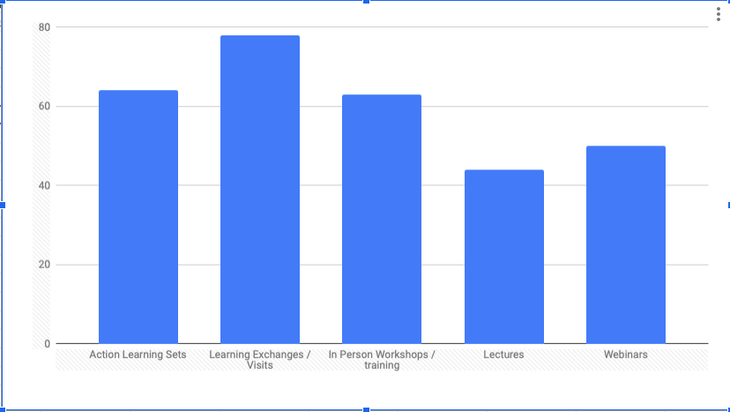
How might we best continue to engage?

Slide 41
Who isn’t in the room?
Ministers / government
Community organisers
Business – we need to be less skeptical and bring them in
People with learning disabilities
More commissioners, funders and those with resources
Political groups
Trade unions
Local housing and support providers
Younger people / social movements that get losing control more intuitively
UX researchers

