Slide 1
The Inclusive Economy Partnership:
There’s Power in Partnerships
Shevaun Haviland, Cabinet Office
James Ashall, Movement to Work

Slide 2
Agenda
An introduction to the Inclusive Economy Partnership
Shevaun Haviland, Deputy Director of Business Partnerships, Cabinet Office
The Transition to Work Pilot in the West Midlands
James Ashall, CEO Movement to Work
Panel discussion: There’s Power in Partnerships (Facilitated by Shevaun Haviland)
James Ashall, CEO Movement to Work
Matthew Poole, Senior Head of Regional Grant Making, Midlands, Big Lottery Fund
James Lindsay, Employment & Skills Delivery Lead, West Midlands Combined Authority
Amerah Saleh, General Manager, Young Giant Beatfreeks Collective
Sipho Ndlovu, member of the Beatfreeks community
Q&A

Slide 3
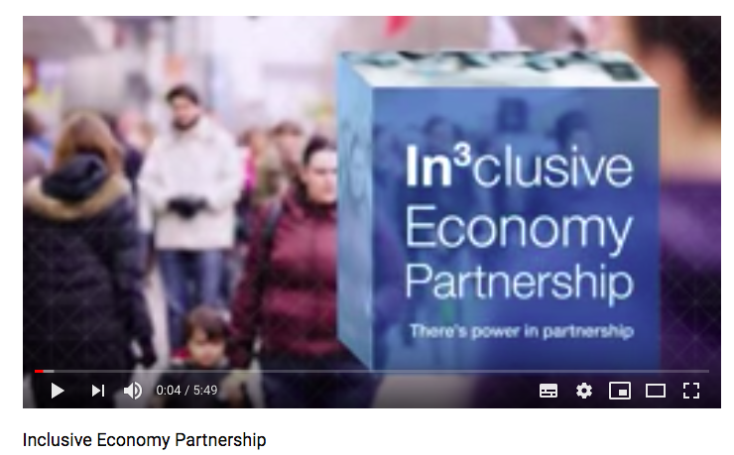

Slide 4
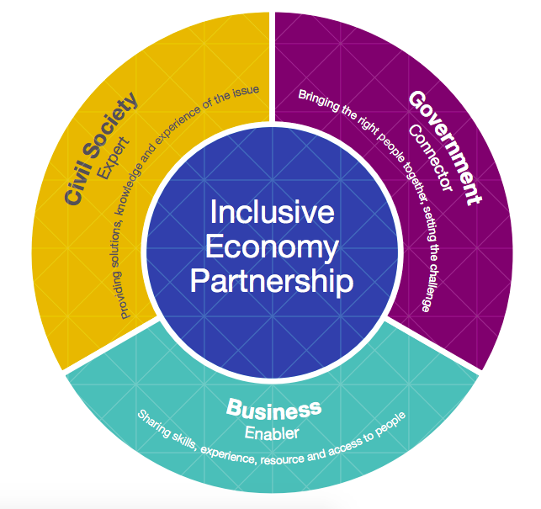
What is the Inclusive Economy Partnership?
We’re a partnership of businesses, civil society and government departments who are working together to solve some of society’s toughest challenges, to help all communities and everyone within them feel they belong to and can participate in the UK economy.
We believe in the power of partnership. And through collaboration, innovation and a shared determination to make the UK a better place to live and thrive, the IEP is part of a growing global movement that’s trying to solve age-old problems with new ways of thinking.

Slide 5
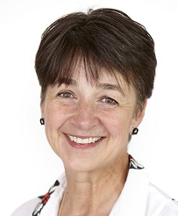
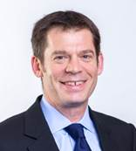
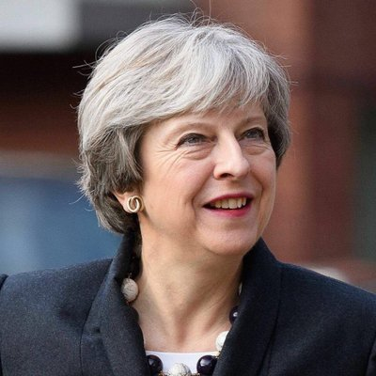
“An inclusive economy is ultimately about community; employees, public servants, citizens. Our aim is to work together to create a fair society made up of vibrant and prosperous communities where people have a meaningful stake in a shared economic model.”
Caroline Mason CBE
CEO, Esmée Fairbairn Foundation
“As a mutual we believe in the power of collaboration - that we achieve more together than we can alone. That’s why the IEP is a welcome initiative and a natural fit for Nationwide Building Society.”
Joe Garner
Chief Executive
Nationwide Building Society
“...we will make Britain a country that works not for a privileged few,
but for every one of us.
That will be the mission of the government I lead,
and together we will build a better Britain.”
Theresa May, UK Prime Minister

Slide 6



We are currently focused on three flagship challenges:
Against each of these challenges, the Partnership has launched a number of collaborative projects and supported social innovators to scale what they do.
Financial Inclusion and Capability
Mental Health at Work
Transition to Work

Slide 7

Our vision and ambition
Local
Innovative solutions delivering greater impact for people and communities
National
A more inclusive economy and society
Global
UK positioned as a world leader on inclusive growth

Slide 8

The story so far
March 2017
March 2018
September 2018
4 Big Ideas
Open Banking For Good
Access to Affordable Credit
Mental Health Reporting
Discovery
170+ organisations engaged
9 workshops
3 themes
Transition to Work
Partnership Accelerator
90 one-to-one coaching sessions
9 events
£20,000 HMG grant each

Slide 9


















Partnership Accelerator: The first cohort of 18 innovators...

Slide 10

Results: scaling innovation
Partnership Accelerator greatly exceeded expectations
50,000
18
social
innovators
additional people will
now benefit from:
100
partnerships formed
from
230
fairer and more informed access
to financial services
access to services that support
their mental health
tools to improve young peoples’
access to the job market.
introductions
Forecast
£3.2m
additional
revenue in
next 12 months
£630,000
grant funding
by Sept 2018

Slide 11



Four Big Idea Projects are in progress...
Access to Affordable Credit
DCMS, with cross-government support, is drawing on the expertise of IEP members to explore and develop new ways of stimulating the market into making more affordable credit available to the public.
Open Banking for Good
Nationwide and other IEP members have launched a challenge prize that will help find and scale ways to improve financial inclusion and capability using the Open Banking technology changes.
Mental Health Reporting
The Department for Work and Pensions, alongside IEP members and the Disability Confident Business Leaders Group, have collaborated to create a framework for voluntary mental health, wellbeing and disability data collection and public reporting.
Transition to Work
Accenture, Movement to Work, O2, UnLtd, Youth Employment UK and a host of other organisations are teaming up with the West Midlands Combined Authority to pilot a fresh approach to supporting young people into sustainable work.

Slide 12




Transition to Work
(The West Midlands Pilot)
@MovementToWork #YoungPeopleWork
@MovementToWork #YoungPeopleWork
Notes:
Hi – Intro
Thanks

Slide 13


Our Purpose
Our Vision
Our Ambition
Our Ethos
Notes:
WE ARE A NOT-FOR-PROFIT COALITION OF UK EMPLOYERS WHO TACKLE YOUTH UNEMPLOYMENT AND INVEST IN THE FUTURE OF OUR ECONOMY
WE EXIST TO EMPOWER, YOUNG PEOPLE most in need of support TO FULFILL THEIR POTENTIAL THROUGH WORK
…to level the playing field for all young people by removing barriers to employment through quality work-placements and other job opportunities.
Our hope is that they have the same access to jobs as the rest of scoeity and that they no longer remain 3x more likely to be unemployed.
But we’re really clear on our role – its to galvanise business and show them the path to support young people. We are business ot business organisation

Slide 14
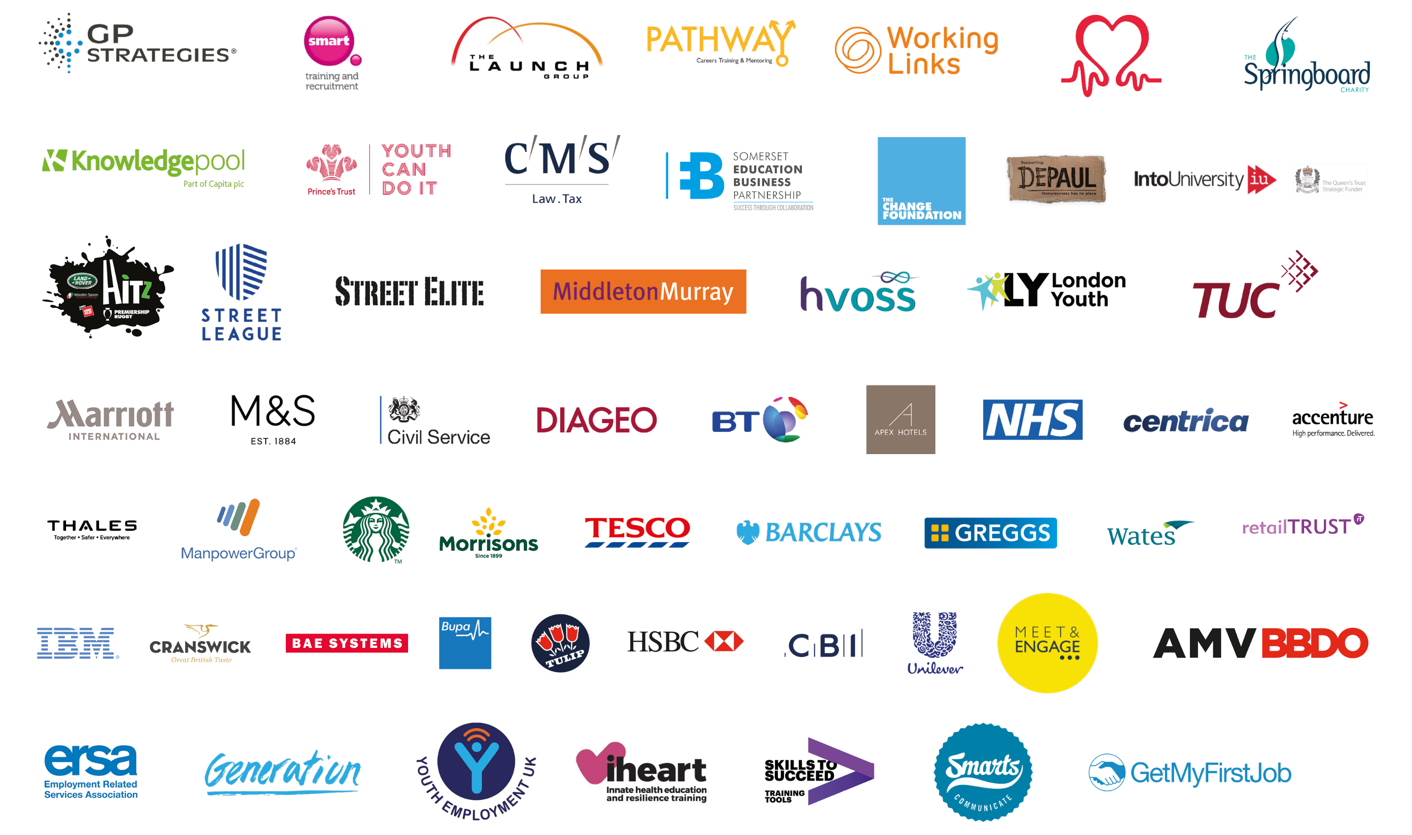

Notes:
And this approach is working – across our coalition we’ve delivered over 80,000 work placements with more than 50% of those completing placements going onto jobs. If you were to try and equate that to a number its over £1bn of benefit to the economy.
Wee bring them together and shoe them best practise, we support them through the complex landscape andw e connect them to deliver better outcomes for young people/

Slide 15
Transition to Work
(The West Midlands Pilot)
@MovementToWork #YoungPeopleWork
@MovementToWork #YoungPeopleWork
Notes:
And that is why I like the IEP approach

Slide 16























@MovementToWork #YoungPeopleWork
@MovementToWork #YoungPeopleWork
Notes:
At it’s core the ethos is the same – by coming together we can do more – if we can bring the power of movement to work in collabraoration with more great organsations our impact will be bigger , we will halpe more young people than if we follow our path. – That is what Transsiton to Work is about and what we are going to achieve in the west Mids.
IT is about business, civil society and govt coming together – but with a very specific focus

Slide 17

@MovementToWork #YoungPeopleWork
Notes:
Right now hundreds of employres, engaging thousands of schools and hundreds of charities to solve the problem is not getthing young people the outcomes they deserve.
3x more likely to be unemployed is not acceptabl

Slide 18

@MovementToWork #YoungPeopleWork
Notes:
Connecting all of the people we need together
Building on the great work we have
Add a key image on collaboration
Surely by connecting these pieces we must be able to do more – to achieve more
Thats what this is about – the power of collecgive impact

Slide 19
Governance
Team
Shared Objectives
Tracking outcomes
@MovementToWork #YoungPeopleWork
Notes:
Collaboration and collective impact is built into the core of how we are built and what we are doing

Slide 20
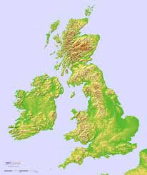

A National challenge that needs an individual solution
@MovementToWork #YoungPeopleWork
Notes:
It’s all well and good talking about the 750,000 Young people that are NEET or even the 14,000 unemployed in Birmingham, but unless we get down to the level of communities group and individuals we won’t succeed.

Slide 21
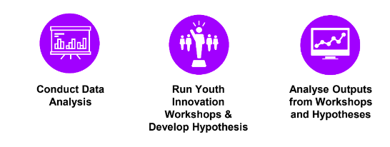
A National challenge that needs an individual solution
@MovementToWork #YoungPeopleWork

Slide 22
A National challenge that needs an individual solution
17-year olds
Care leavers
Pakistani, black and Asian young people
Washwood Heath, Lozells, Sparkhill, Aston and Handsworth
Long Term unemployed
@MovementToWork #YoungPeopleWork
Notes:
We need to adapt the model we have to make it work for these groups – draw the scale mode back to those who need the support.
17-year olds who have completed one year in college. This is a sizeable group and a key point of intervention to prevent unemployment as they reach adulthood
Care leavers are disproportionately likely to be in the unemployed group. This is a clearly identifiable group and there is some brilliant work emerging with employers and housing organisations that we can look to share and scale
Pakistani, black and Asian minorities as they are most likely to be over represented in youth unemployment statistics
Washwood Heath, Lozells, Sparkhill, Aston and Handsworth because these areas have high concentrations and volumes of young claimants
Those who have been in long-term unemployment for 12-24 months

Slide 23
Scaling interventions that work
Innovate to create more connection
@MovementToWork #YoungPeopleWork
@MovementToWork #YoungPeopleWork
Notes:
interventions
No reinvention
Building from great local initiatives
roach

Slide 24
Getting Involved
Employers: Commit placements to the target groups
Connect young people via existing networks
Mobilise Supply Chains – large feeds small
@MovementToWork #YoungPeopleWork
@MovementToWork #YoungPeopleWork
Notes:
Create work placements and commit to allocating a number of placements to the key target groups
Where possible, link work placements to entry level jobs either within your organisation or with other employers
Leverage employers’ supply chains and support small and medium-sized enterprises to take part in work placement programme to broaden reach in the region

Slide 25
Panel discussion:
There’s Power in Partnerships?
James Ashall, CEO Movement to Work
Matthew Poole, Senior Head of Regional Grant Making, Midlands, Big Lottery Fund
James Lindsay, Employment & Skills Delivery Lead, West Midlands Combined Authority
Amerah Saleh, General Manager, Young Giant Beatfreeks Collective
Sipho Ndlovu, member of the Beatfreeks community

Slide 26



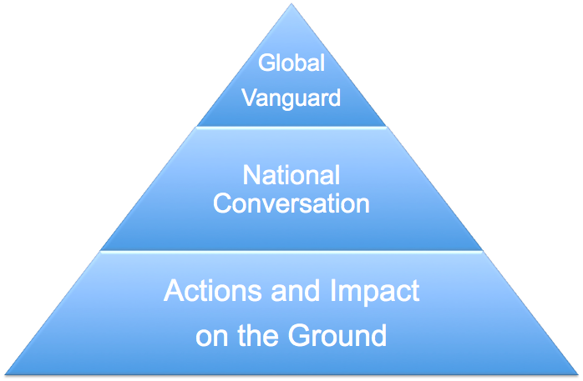

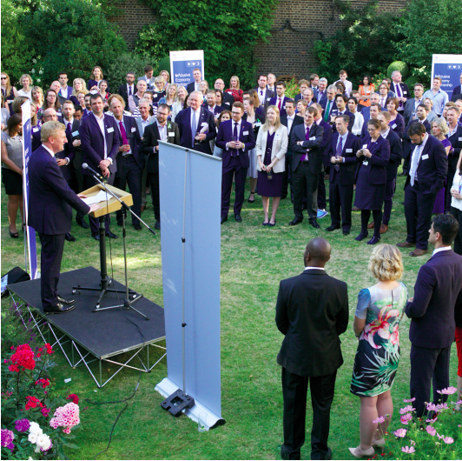
Get in touch iep@cabinetoffice.gov.uk
Subscribe to the newsletter
https://www.gov.uk/government/groups/the-inclusive-
economy-partnership
Join the discussion #InclusiveEconomy

