Slide 1
Paula Harriott Sameer Iqbal Jay Arnold Kevin Heffernan Losing Control Conference 5/2/19 Peer working in Liaison and Diversion

Slide 2
Losing Control 2019

Slide 3
Losing Control 2019
Power-
the capacity or ability to direct or influence the behaviour of others or the course of events.
Relationship –
the way in which two or more people or things are connected, or the state of being connected.
Collaboration-
when two individuals or a group of people work together towards achieving a common goal by sharing their ideas and skills.

Slide 4
Losing Control 2019
Coproduction can easily become consultation and never truly challenge the power dynamic.
It may even reinforce it by ticking the box of ’service user involvement’.
In the North Midlands NHS England Health and Justice Team they weren’t prepared to let that happen.
So, they started employing ex-prisoners and progressing them up the ranks not because of their professional skills but because of the value of their lived experience, with exciting results.
It goes without saying it wasn’t easy, not least because it truly challenged the established culture, structure and set of processes.
What were these challenges and how did they overcome them?
What were the results?
What can you learn and apply from their experience?

Slide 5
https://www.youtube.com/watch?v=sHLv5JVv3xw
#LiaisonAndDiversion

Slide 6
National Liaison & Diversion
NHS England commissioned service delivering a national all-age service specification, co-designed by those with lived experience
National Operating model focusing on any vulnerability including Mental ill health, Drug & Alcohol misuse, learning disability etc
National programme status due to be completed and rolled into BAU by end March 2020
Police stations, courts, outreach

Slide 7
Liaison and Diversion Services
NHSE overarching strategy to:
Improved access to healthcare and support services for vulnerable individuals in police custody and courts
Reduce Health inequalities
Delivery of efficiencies within youth and criminal justice systems
The reduction of re-offending
The reduction of health inequalities
The reduction of first time entrants into CJ system
Better information flow from Health service to CJS decision makers

Slide 8
Notes:
I think this is the place where we really need to sell the ambitions of L&D focussing on the opportunities for a positive impact upon those who may be considered to have “offended,” those who may be future victims and the impacy upon the public purse(?)

Slide 9
https://www.bsmhft.nhs.uk/our-services/secure-care/criminal-justice-liaison-and-diversion-team/
#LiaisonAndDiversion

Slide 10
Peer support
A Peer Support model as part of L&D has been co-designed by the national Lived Experience Team with support from the National Team
The national model was trialled in two pathfinders sites – Birmingham and Wiltshire; a further two sites (Wakefield and Berkshire) are also in the process of implementing the model
Revolving Doors Agency have undertaken an independent review of the model – their recommendation is a hybrid model
Peer Support will become part of the national L&D Service Specification next year
#LiaisonAndDiversion

Slide 11
Peer support
What is peer support?
“The term Peer Support describes an equal and supportive relationship based on common experience.”
“When the people caught up in the criminal justice system have the opportunity to work with a person who historically has shared that experience, it often acts to reassure them about the quality and usefulness of the intervention on offer. It does not operate from assumptions of power but is rooted in an equal relationship, and this equality is established by the peer supporters’ willingness to disclose shared experience.”
Jim Burdett (Director Mind & Body Learning and Development)
#LiaisonAndDiversion

Slide 12
Peer support
Research literature points to multiple benefits evolving from peer support; for the client,
the peer supporter and the wider services and community.
Using a shared experience to enable trust to develop between those who are typically hard to engage and the peer supporter. (Gillard et al., 2014)
The peer supporters serving as valuable and credible models of the possibility of recovery for both the clients and criminal justice professionals. (Gillard et al., 2014)
Peer supporters can model useful skills and effective problem-solving strategies, and respond in a timely fashion to prevent or curtail relapses and other crises. (Gillard et al., 2014)
It can challenge negative attitudes of staff and provide an inspiration for all members of the team.
Being employed as a peer worker is generally seen as a positive and safe way to re-enter the job market and thus resume a key social role (Mowbray et al., 1998)
Peer supporters feel empowered in their own recovery journey (Salzer & Shear, 2002), have greater confidence and self-esteem (Ratzlaff et al., 2006) and a more positive sense of identity, they feel less self-stigmatisation, have more skills, more money and feel more valued (Bracke et al., 2008).
#LiaisonAndDiversion

Slide 13
Peer support
Birmingham experience
Essentials at the start of the journey for the commissioner and L and D team
Lived experience of the criminal justice pathway not just MH
Disclosure and Barring Service (DBS) barrier to employment
3rd sector collaboration
Front line targeting high volume users and most difficult to engage
3 months in 3 months out protected in a 2 year contract
Value diversity and perspectives the more we have the more successful we can be
Complimentary role, specialist but not super human!
Embedded in the team not referred onto
Team comes together to share success….outreach workers get the best deal!
Regional forum, inspiring others…..2 becomes 6
5 short narratives
Short term sentence
First day for Stoke peer worker
Our latest youth peer worker’ journey
Substantive employment for first peer workers
Skills for Health
#LiaisonAndDiversion

Slide 14
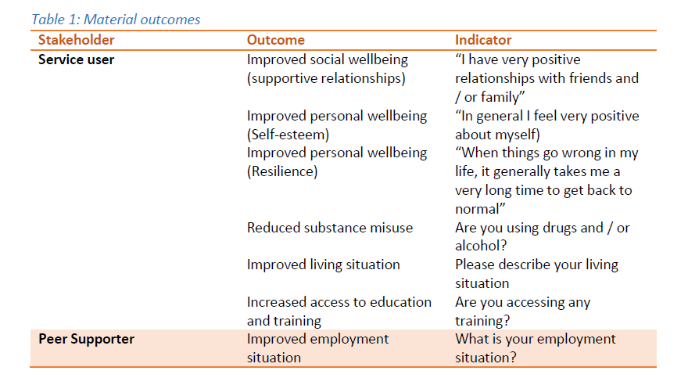
#LiaisonAndDiversion

Slide 15
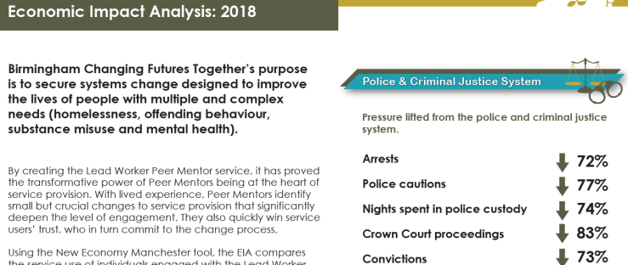
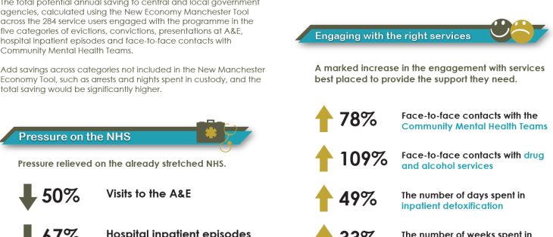
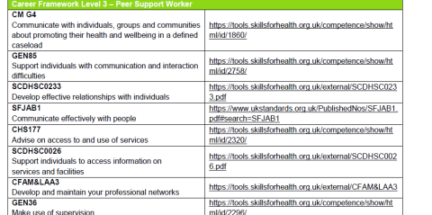
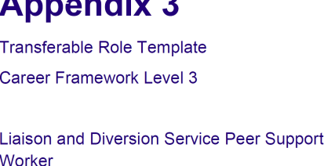
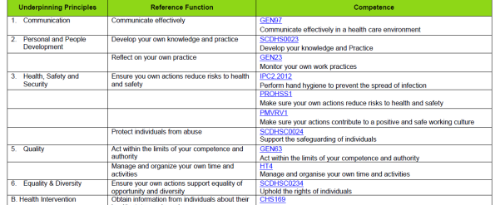
Peer support
Useful resources
Economic Analysis of the powerful effect of peer working
https://changingfuturesbham.co.uk/workstreams/learning-and-evaluation
Skills for Health
Liaison and Diversion career and competency framework including a role template for peer workers
http://www.skillsforhealth.org.uk/results?q=Liaison+and+Diversion
#LiaisonAndDiversion

