Slide 1


An Introduction to
Participatory Budgeting (PB)
Alan Budge
PB Partners

Slide 2




PB PARTNERS
I N T R O D U C T
I O N
Independent social enterprise that is
working to empower citizens
Supporting new ways of doing PB
Community engagement specialists
PB Network: Advocating for PB across the UK
www.pbnetwork.org.uk and supporting PB in Scotland
2
2
Notes:
2

Slide 3

WHAT IS PARTICIPATORY BUDGETING?
D
E
F
I
N
I
N
G
P
B
‘PB directly involves local people in making decisions on the spending and priorities for a defined public budget.’
Or…
‘Local people deciding on how to allocate part of a public budget’
Or……
‘If it feels like we have decided ---- it’s PB.
If it feels like someone else has decided, it isn’t”
(Brazilian resident)
3

Slide 4
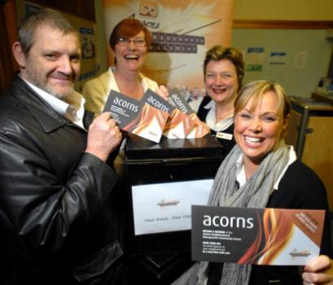
Connecting and complementing existing democratic processes
D
E
F
I
N
I
N
G
P
B
Only a small percentage of any public budget will be allocated using PB
Formally mandated and ‘signed off’ by the elected legislature... ... but then the decision is ‘the communities’
Supports:
Representative Democracy
Public Service Reform
Community Development
4
Notes:
Key thing here is elected members/officials are leaders and facilitators of an empowering community process – with the principles put into action, they enhance the democratic understanding of what communities would spend their money and therefore able to make better informed spending decisions

Slide 5
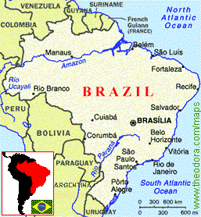
ORIGINS OF
PARTICIPATORY BUDGETING
Began in Porto Alegre, Brazil in 1980s – city of 1.5m people
End of military dictatorship and election of Workers’ Party

Slide 6
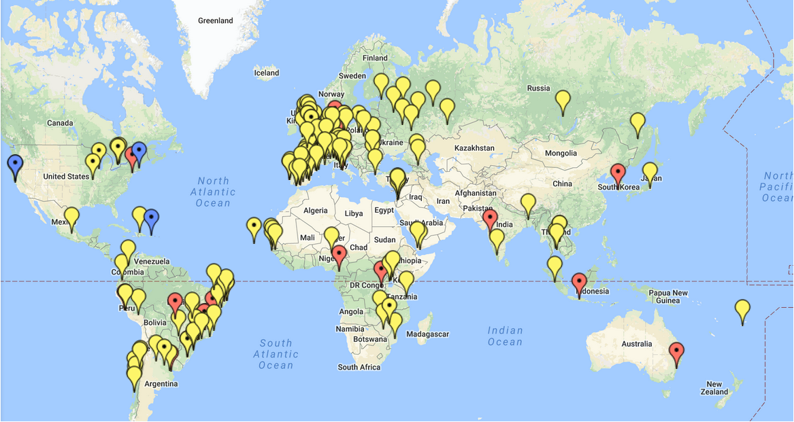
I N T E R N A T
I O N A L
Participatory Budgeting is
Worldwide
6

Slide 7




I N T E R N A T
I O N A L
EUROPEAN PARTICIPATORY BUDGETING
Portugal: 80,000 voters in its 3m euro national PB
Nordic Countries: school/ neighbourhood/ environment
Paris: 426m euros <2020, <5% of the city budget.
USA and CANADA
Chicago: first major programme $1m in 49th Ward (now $4m)
New York: 8th year growing < $35m per year (50,000 voters)
City of Boston: 4th consecutive year of $1m of PB capital funds branded as Youth Lead the Change:
7

Slide 8
PB in Scotland 2014-18
Over £15 million has been allocated by PB across Scotland to date.
All 32 Local Authority areas engaged in some form of PB
Scottish Govt have invested £6.5m in support to PB
Community Choices fund, support to PB programme development
Participatory budgets ranged from £750 to £500m
Projects have been delivered under a wide range of themes – health
and social care, economic development, transport etc.

Slide 9
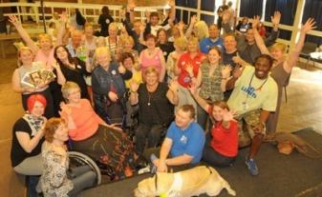

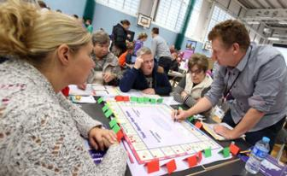
PB MODELS
D
E
F
I
N
I
N
G
P
B
Small grants allocation
Mainstream Investment
Commissioning, community
planning and budget
development and consultation
9

Slide 10
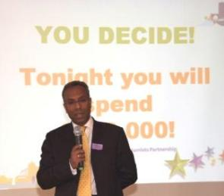
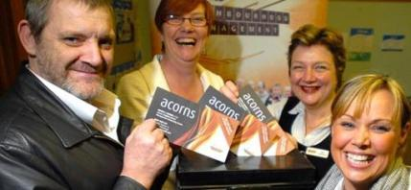
Small grants allocation
A grants pot / initiative funding
- community chest, etc
Bidders present proposals to residents,
who vote on which to support
Limited impact on mainstream
Effective at engaging, networking
and enthusing local people

Slide 11
Mainstream Investment
Residents commission services from service providers.
Scottish Govt commitment to 1% of Local Authority budgets allocated via PB.
- EDINBURGH: £500K of youth provision budget.
- WESTERN ISLES – £500K bus programme
DUNDEE - £1.2m across disadvantaged wards
-N AYRSHIRE £1m Grounds Maintenance Budget

Slide 12

MAINSTREAM PB –
THE BUDGET MATRIX
MA
I
N
S
T
R
E
AM
I
N
G
PB
12

Slide 13
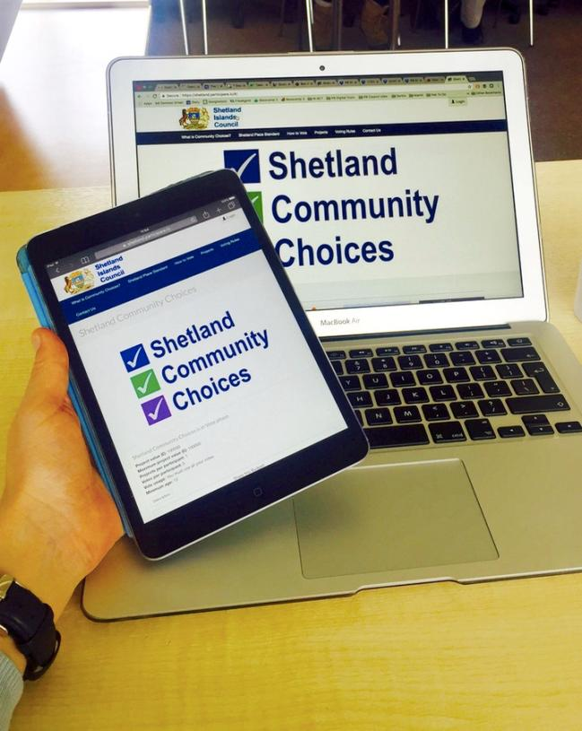

D
I
G
I
T
A
L
P
B
ONLINE PARTICIPATORY BUDGETING
Digital tools and engagement
Connecting on and offline
participation
To reinforce and amplify…
Ideas, engagement, deliberation and voting
13

Slide 14
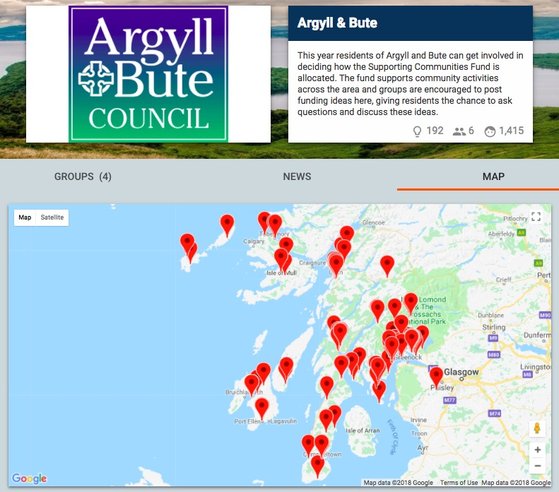
D
I
G
I
T
A
L
P
B
ONLINE PARTICIPATORY BUDGETING
Council grant funding to support Local Communities
£2.5k per project
150 ideas generated online
1,300 people taking part in discussions online
Map shows the spread of ideas
14

Slide 15
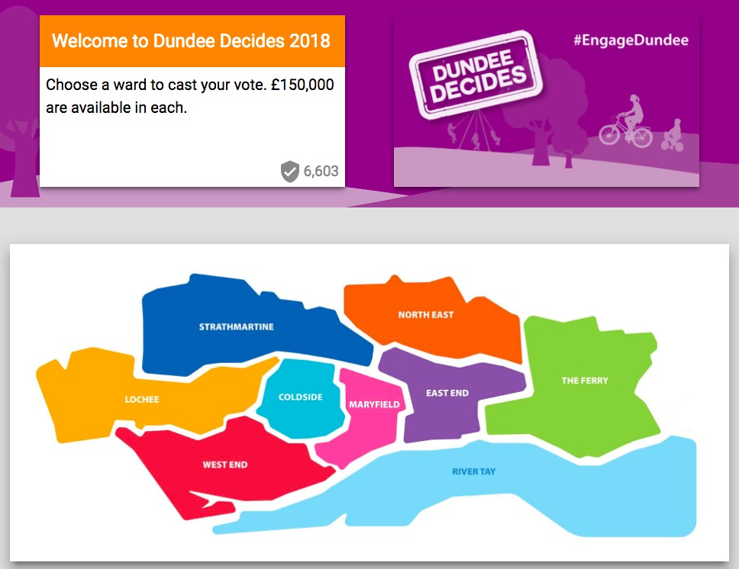
D
I
G
I
T
A
L
P
B
ONLINE PARTICIPATORY BUDGETING
Dundee Decides
£1.2 million Community Infrastructure fund.
11500 votes cast- over 10% of entire eligible voting population.
15

Slide 16
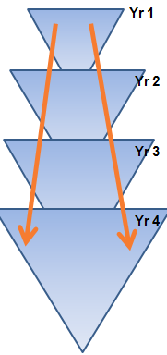
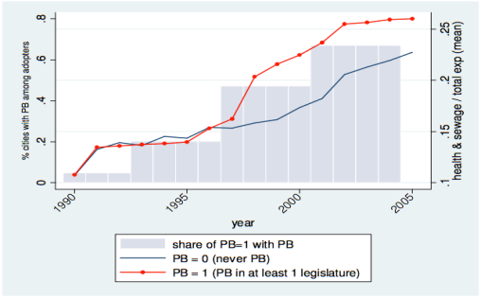
MA
I
N
S
T
R
E
AM
I
N
G
PB
Evaluation and Learning
Design
Scrutiny and Monitoring
PB budget cycle
=
participatory activity at all stages
Informing and engaging
Delivery of new projects
Setting
of
Priorities
Decision Making
Develop budget
Ideas
16
16

Slide 17
“I approached this as a local officer would, who thought I was in charge and I knew best. I was very firmly told by the residents that I wasn’t in charge and I didn’t know best – and they were absolutely right.”
Stuart Pudney: Deputy Chief Executive, Yorks Police Authority
“The PB process has changed (for the better) out of all recognition our relationship with local Council officers and members”
Chris Parsons: local resident

Slide 18
PB - benefits and challenges
What are the benefits of undertaking a PB process?
What are the challenges of adopting a PB approach?

Slide 19
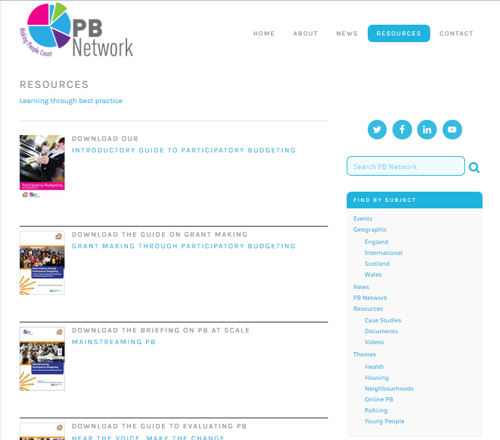
R
E
S
O
U
R
C
E
S
PB Resources:
The UK PB Network Website: www.pbnetwork.org.uk

Slide 20
PB PARTNERS
T H A N K
Y O U
W: www.pbpartners.org.uk
E: alan.budge@pbpartners.org.uk

